Slide 1


INFORMATICS & COMPUTATIONAL SCIENCES
UNIVERSITY COLLEGE OF SCIENCE,
MOHANLAL SUKHADIA UNIVERSITY, UDAIPUR
Bachelor of Computer Applications
(A choice-based credit system)
MINOR PROJECT
ON
CAFEESA-A Cafe website
BATCH: 5th SEMESTER
SECTION: A
SUBMITTED TO: SUBMITTED BY:
Mr. JITESH KUMAR ANAND DUBEY

Slide 2
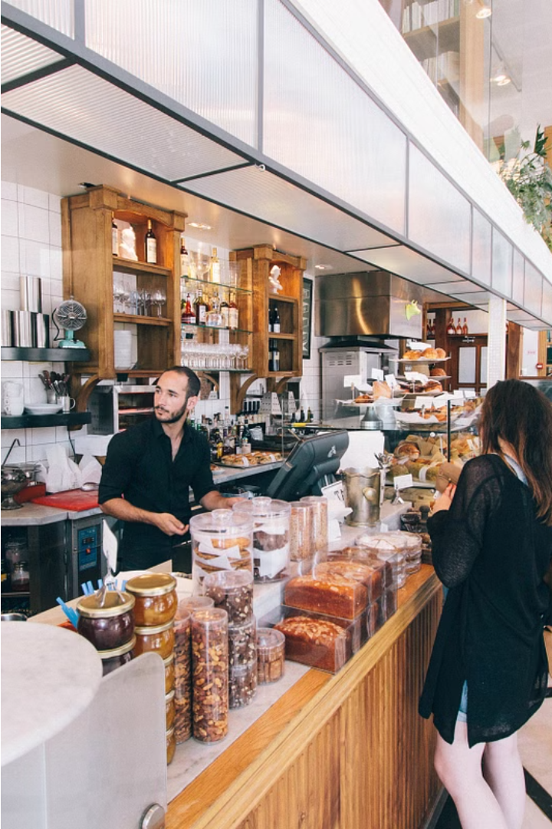

PROJECT
CAFEESA
www.cafeesa-addie.com

Slide 3

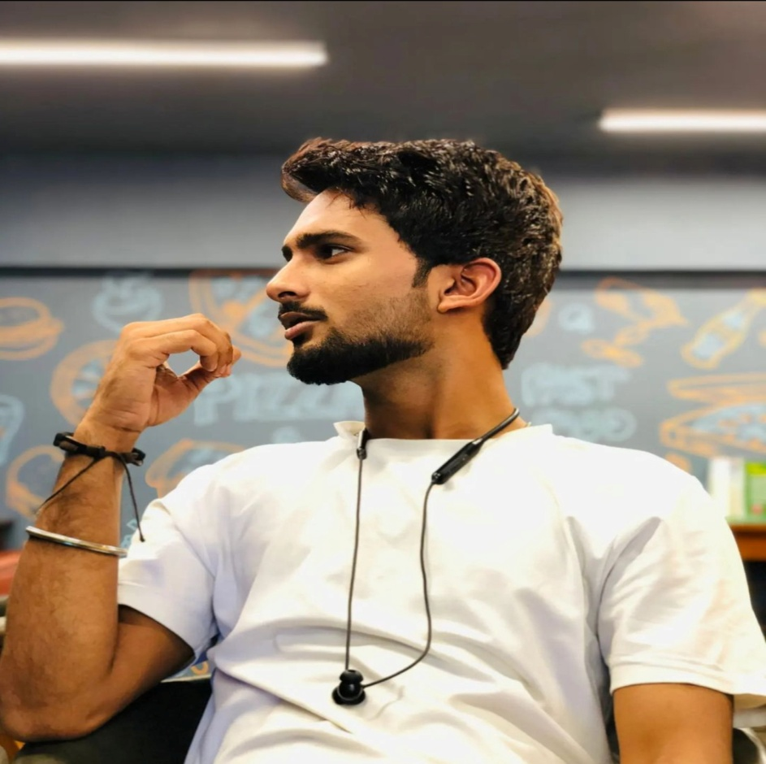

Our Team
ANAND DUBEY
BALWANT BUNKAR

Slide 4
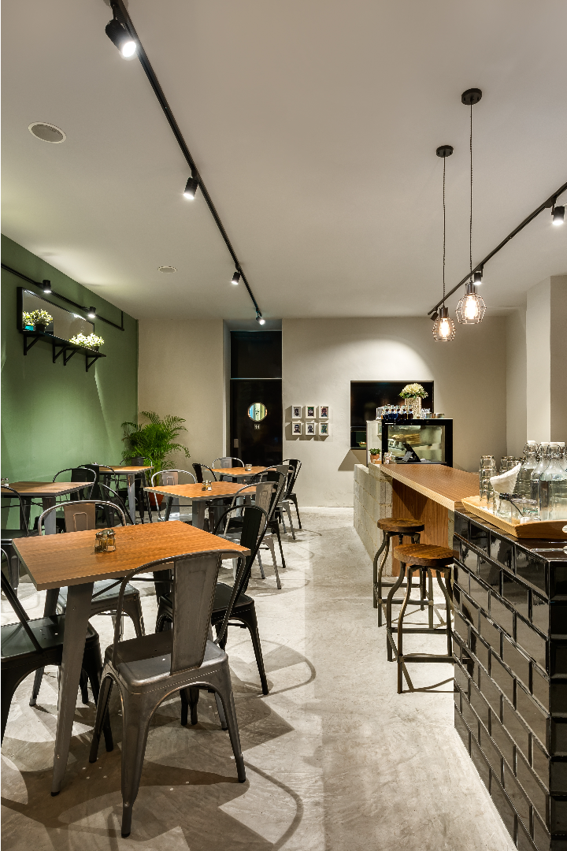

Content
01
02
03
04
05
06
07
08
09
10
Introduction
Objective
hardware
Software
User-module
Admin-module
Admin-module
Database Structure
Conclusion
References

Slide 5
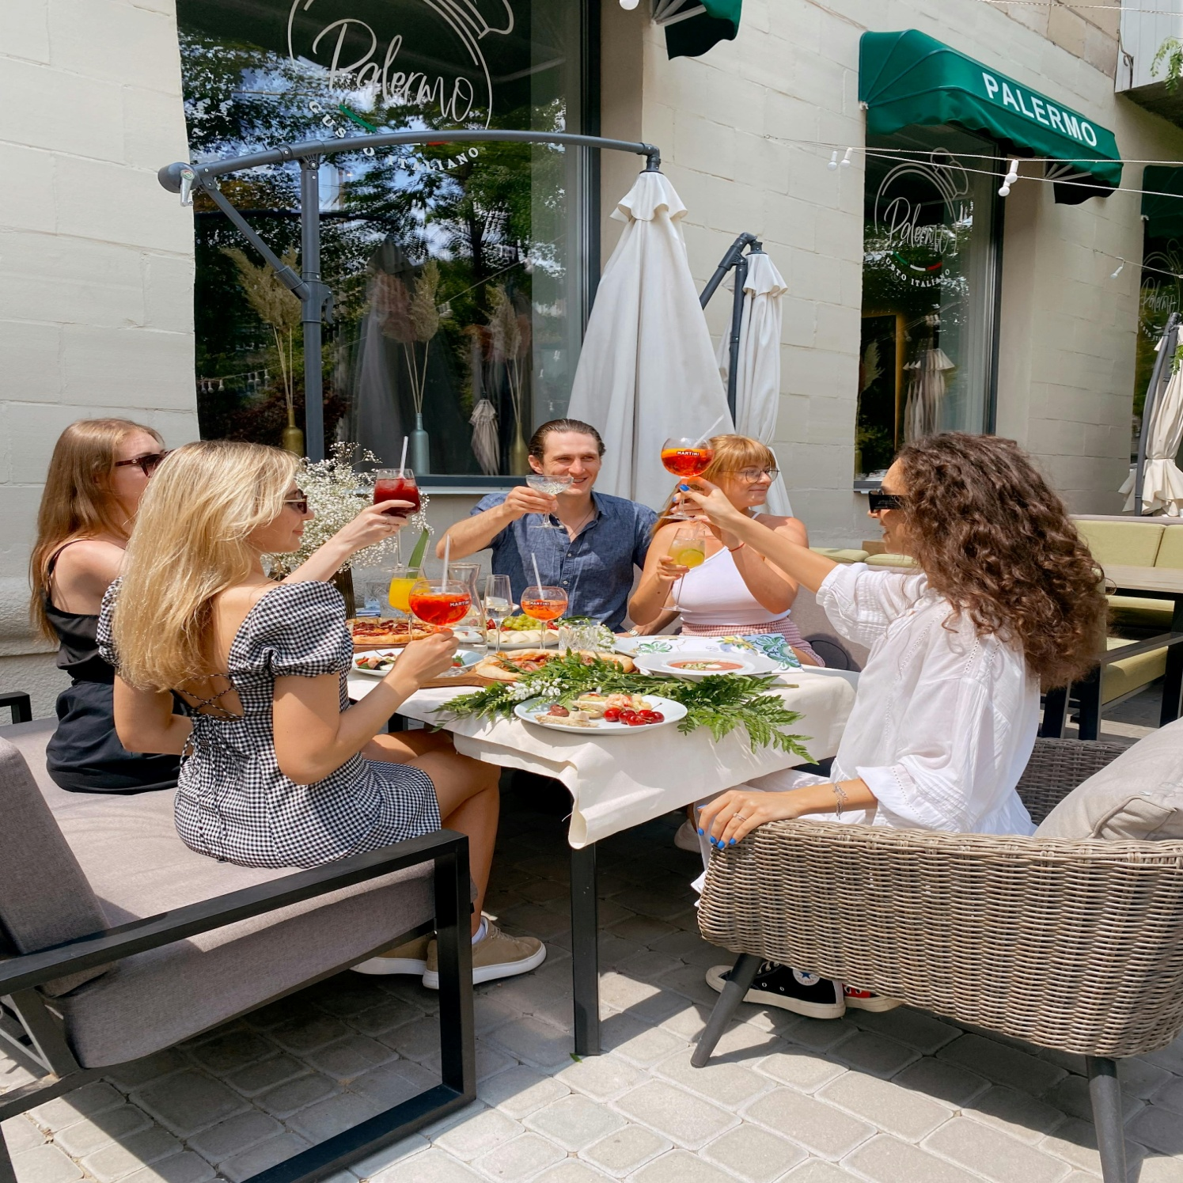

01
Introduction
Cafeesa recognizes the importance of providing customers with convenient and efficient ways to secure their dining arrangements. With the growing demand for online booking services in the hospitality industry, the implementation of a reservation system on the Cafeesa website aims to meet the evolving needs of customers while optimizing operational processes for the cafe.

Slide 6



02
Objetives
01
02
03
Enhance customer satisfaction and loyalty by offering a hassle-free reservation experience, encouraging repeat visits and positive word-of-mouth referrals.
Maximize table utilization during peak hours by implementing a real-time reservation system, thereby increasing revenue generation opportunities for the cafe
Contribute to the long-term success and growth of Cafeesa by aligning with modern consumer preferences and industry trends in online booking services.

Slide 7

03
Hardware
01
SYSTEM
Lenovo Laptop
02
CPU
Intel(R) Core(TM) i3-10110U @2.10GHz 2.59GHz
03
RAM
8GB
04
STORAGE
256GB SSD
1TB HDD
05
STORAGE
Integrated 4GB

Slide 8

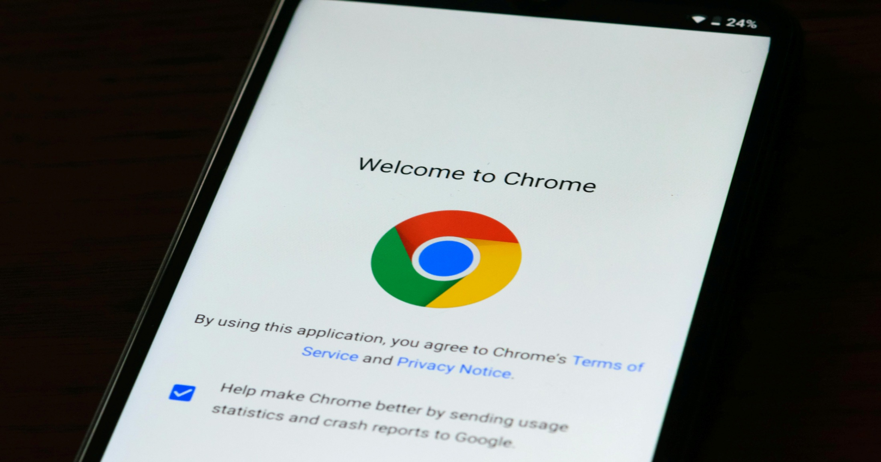
04
Software
VS CODE
Visual Studio Code is a streamlined code editor with support for development operations like debugging, task running, and version control. It aims to provide just the tools a developer needs for a quick code-build-debug cycle and leaves more complex workflows to fuller featured IDEs, such as Visual Studio IDE.
CHROME
Google Chrome is a popular, free web browser. With Chrome browser, you can: Get personalized search results that appear instantly as you enter text. Synchronize bookmarks and settings across all your devices. Use Google Workspace products, such as Google Docs, Sheets, Slides, and more.

Slide 9

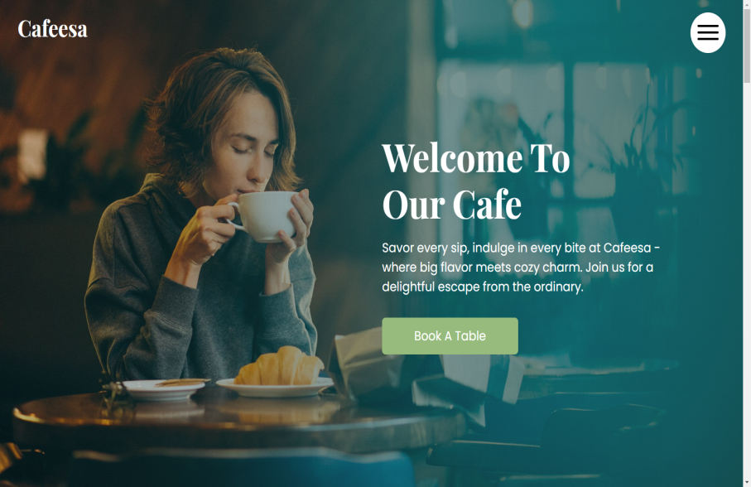
05
User-Module
INDEX-SECTION

Slide 10
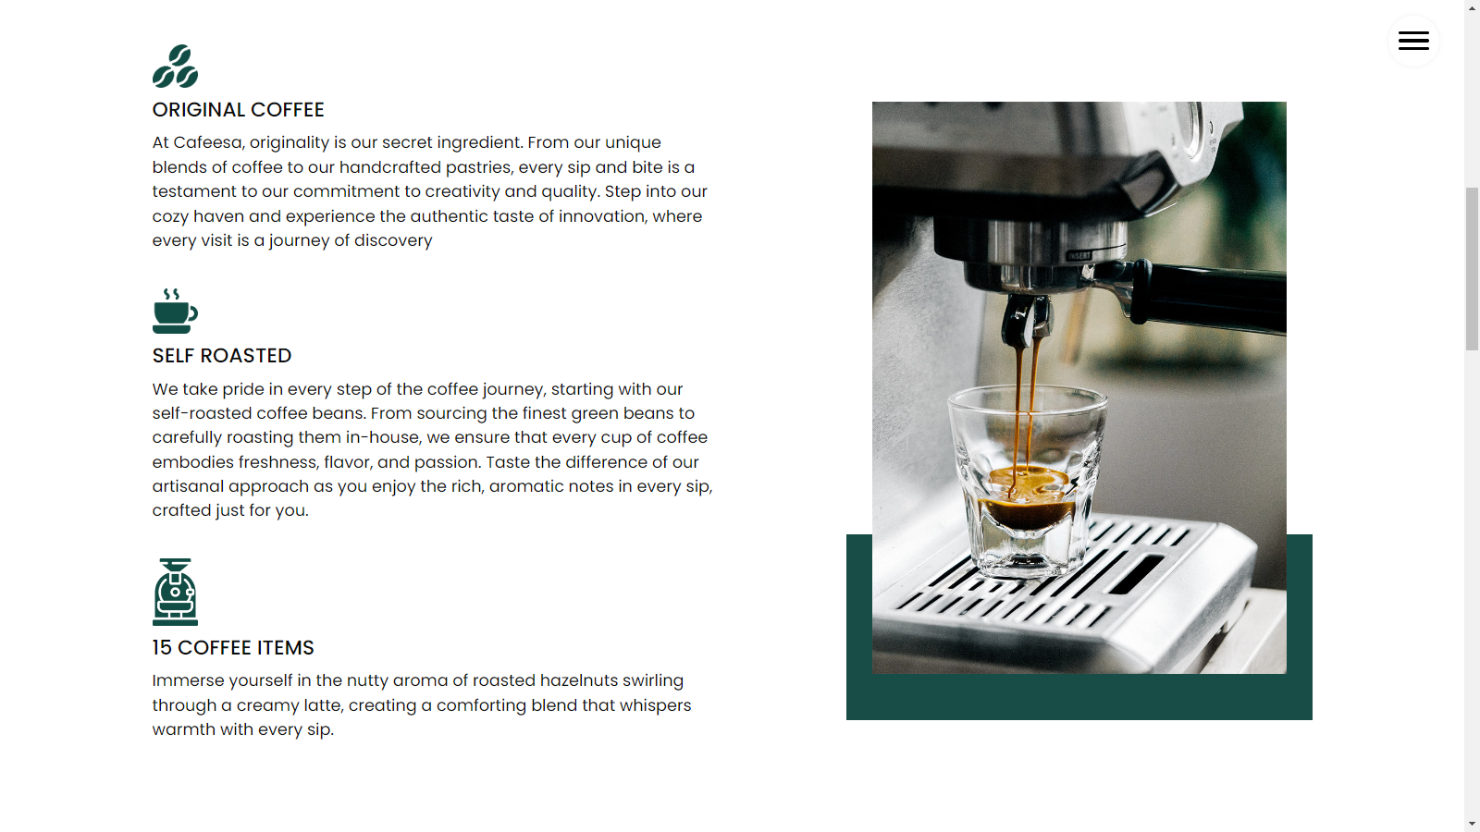
SPECIAL-SECTION

Slide 11
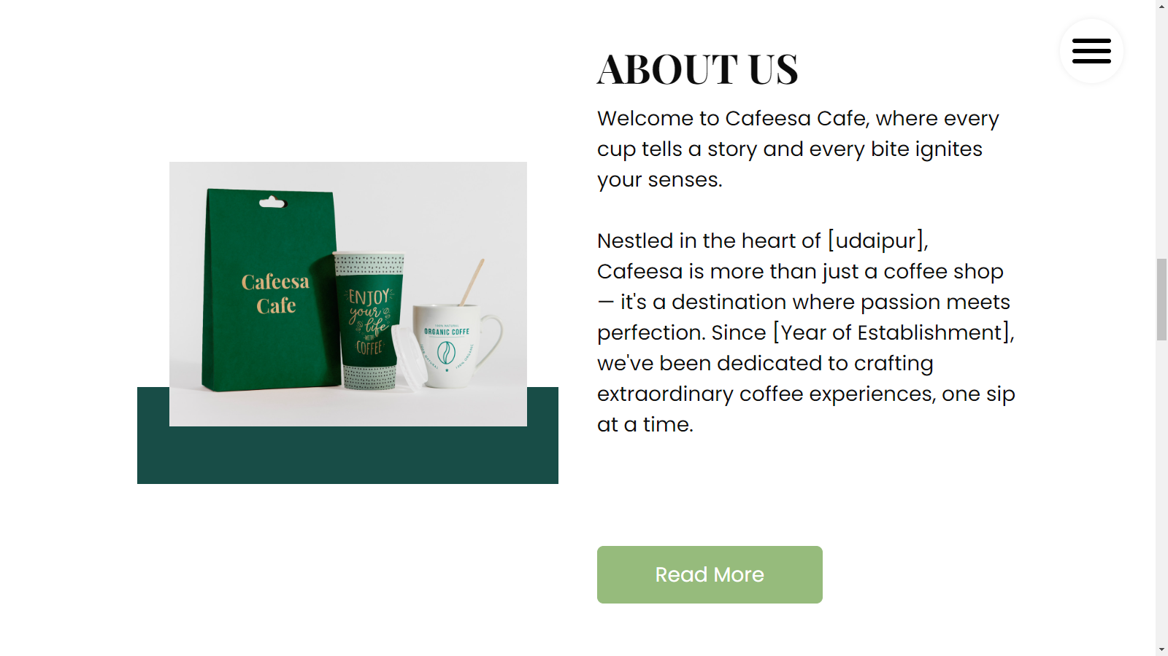
ABOUT-SECTION

Slide 12
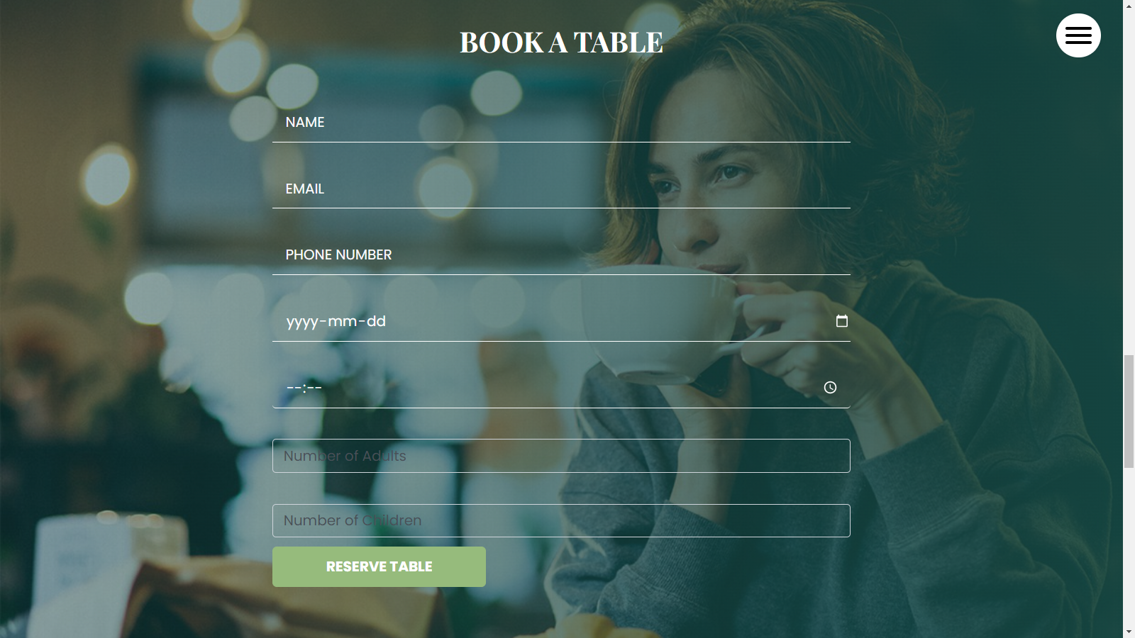
BOOKING-SECTION

Slide 13
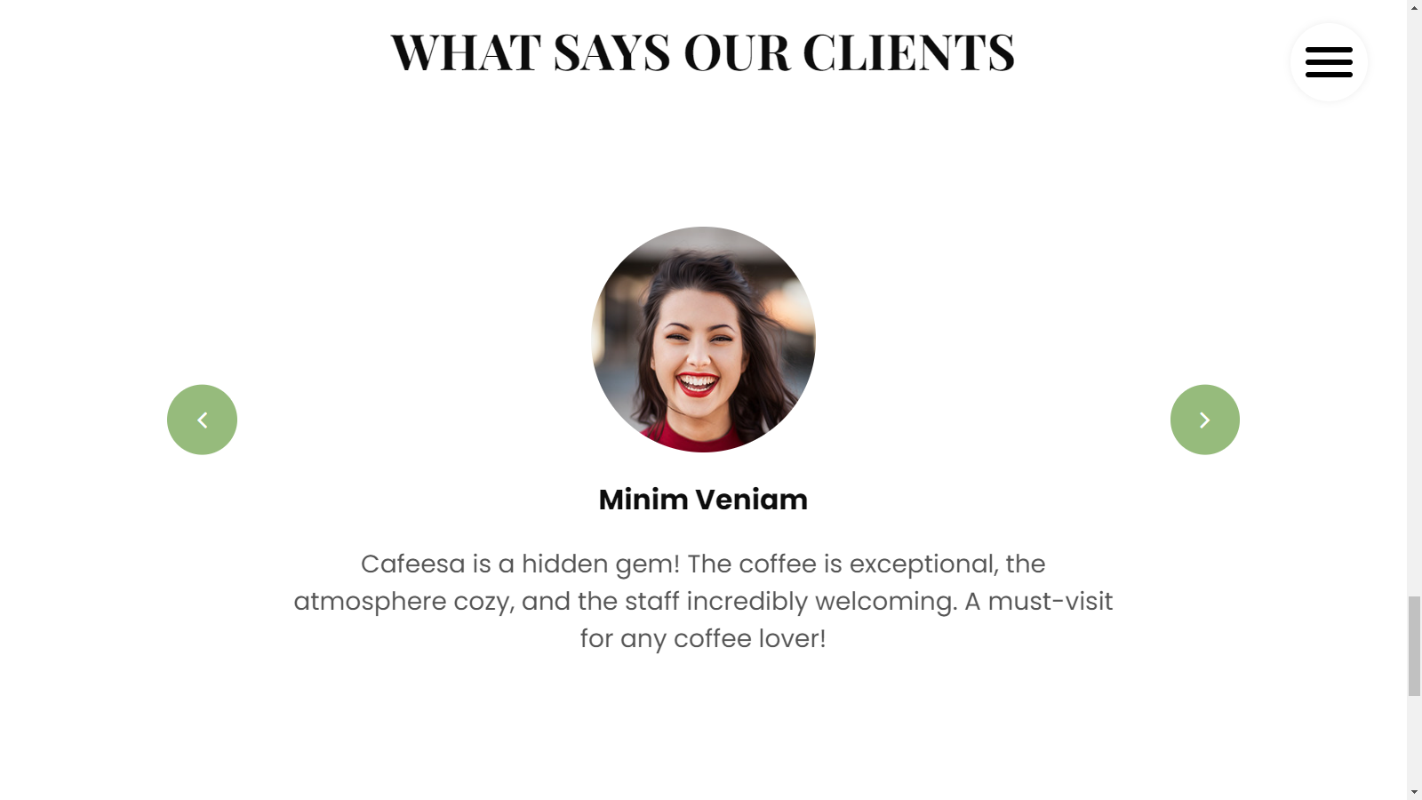
CLIENT-SECTION

Slide 14
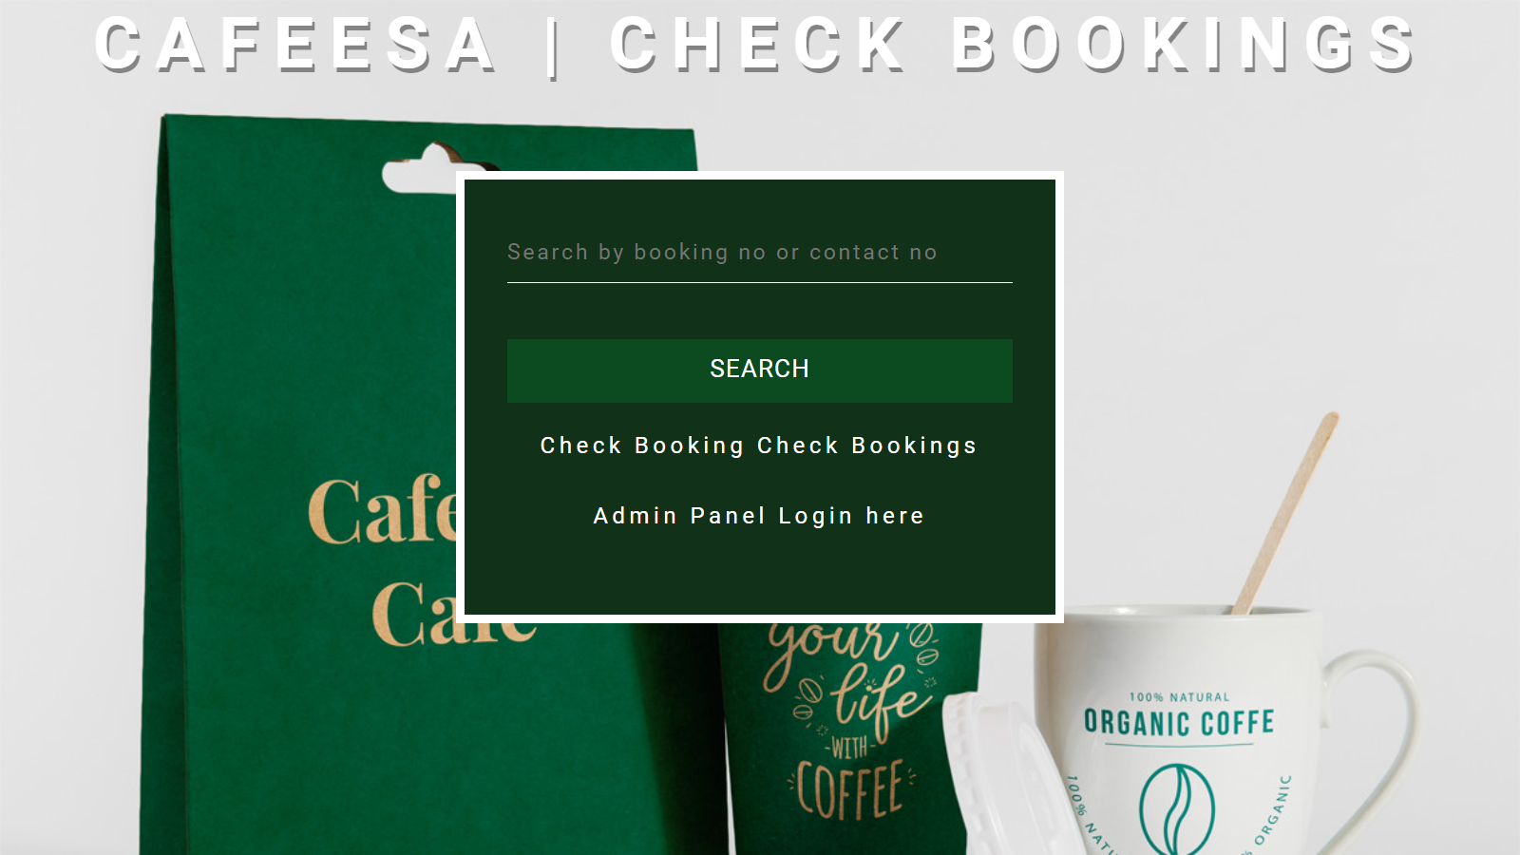
CHECK-STATUS

Slide 15
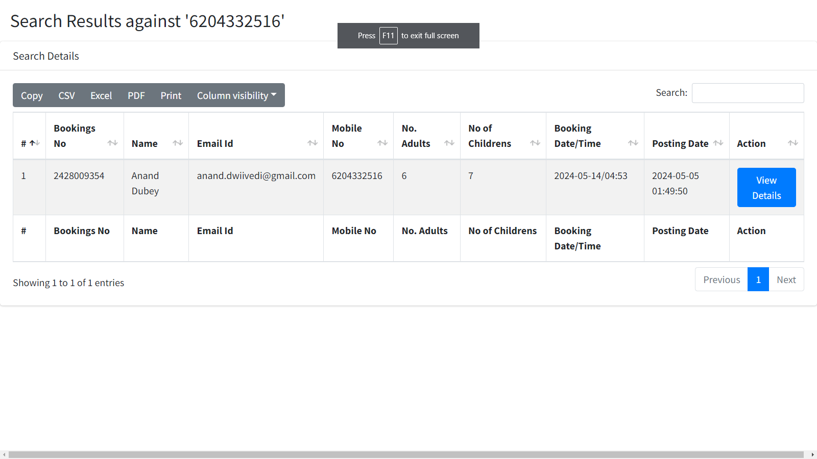
SEARCH-RESULT

Slide 16
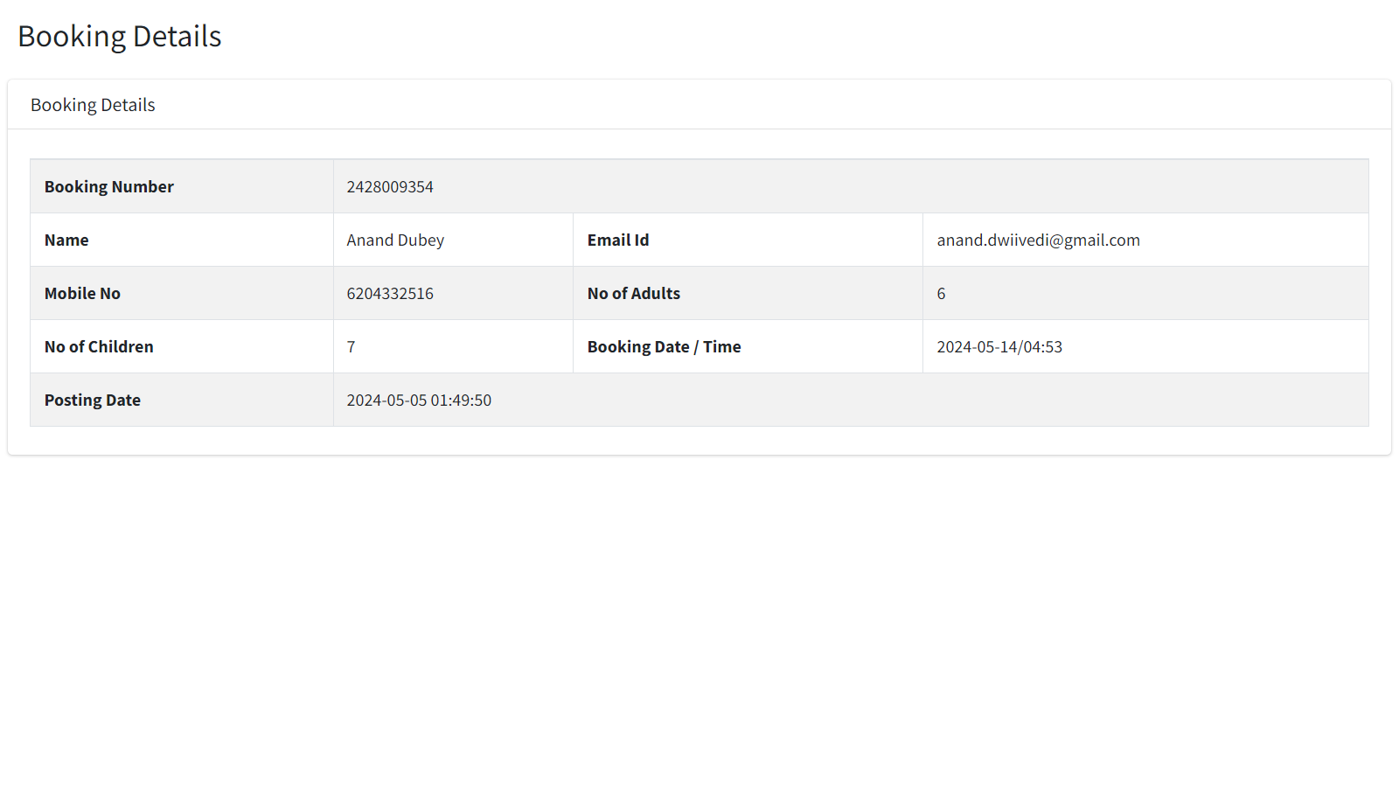
BOOKING-DETAILS

Slide 17

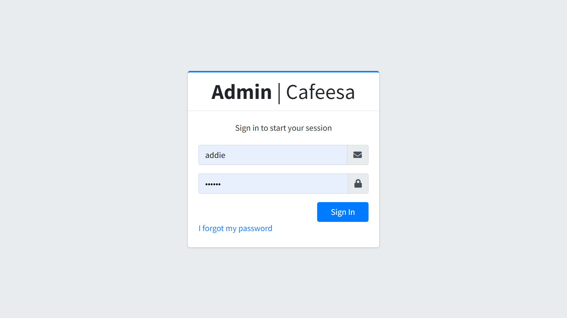
07
ADMIN-Module
ADMIN-LOGIN
This page provides a secure login interface for administrators to access the admin panel. Administrators enter their username and password to authenticate their identity.

Slide 18
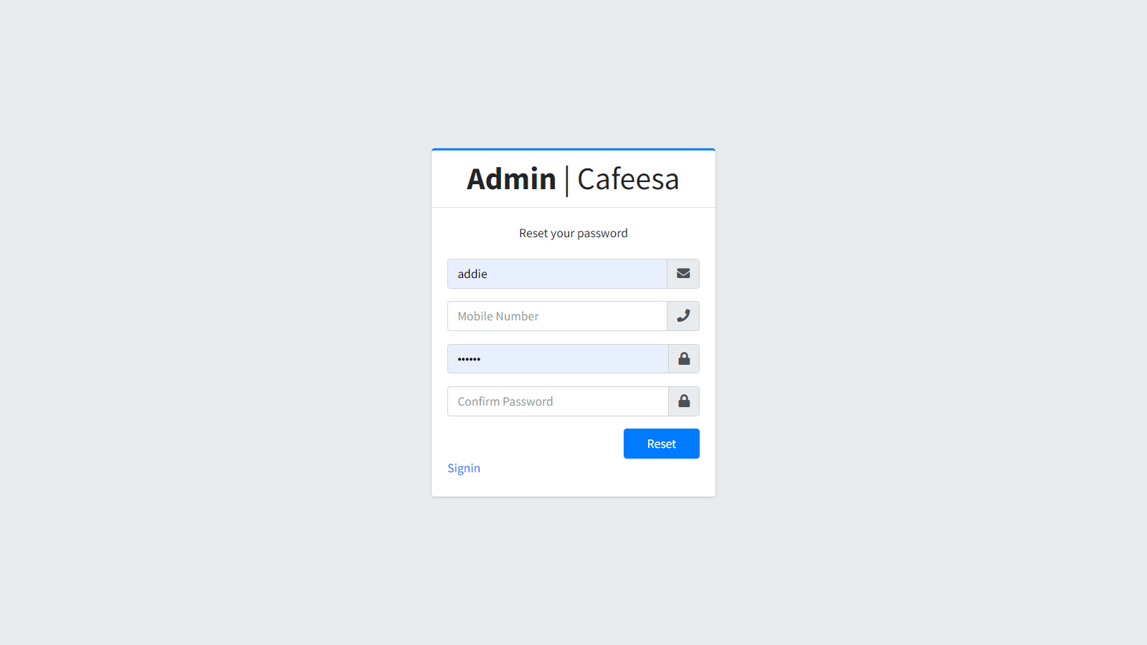
FORGET-PASS
In case an administrator forgets their password, this page allows them to reset it. Administrators typically need to provide their username or email address associated with their account.

Slide 19
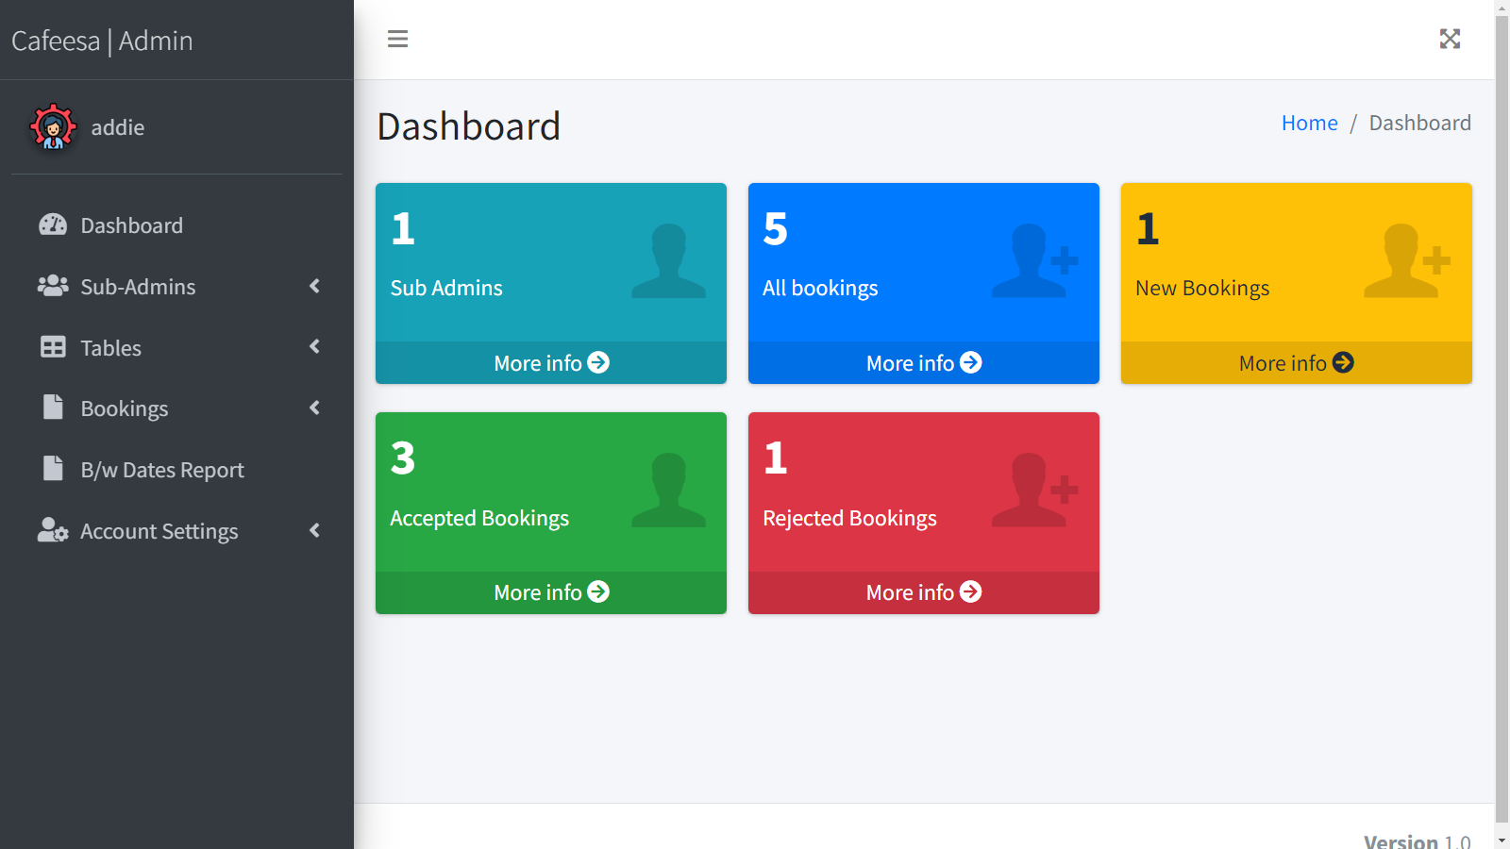
ADMIN-DASH
The central hub of the admin panel, providing an overview of key metrics and activities such as total reservations, revenue generated, and recent activity logs.

Slide 20
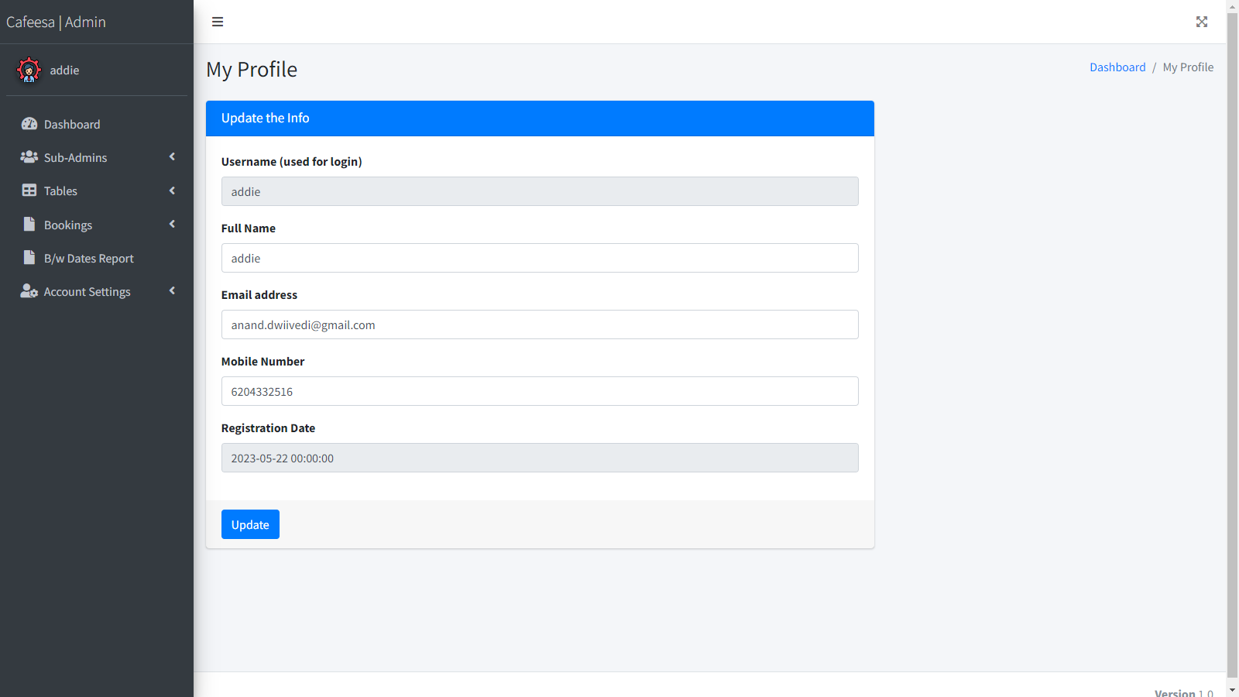
ADMIN-PROFILE
Administrators can view and update their personal details such as name, email address, and contact number directly from within the admin panel.

Slide 21
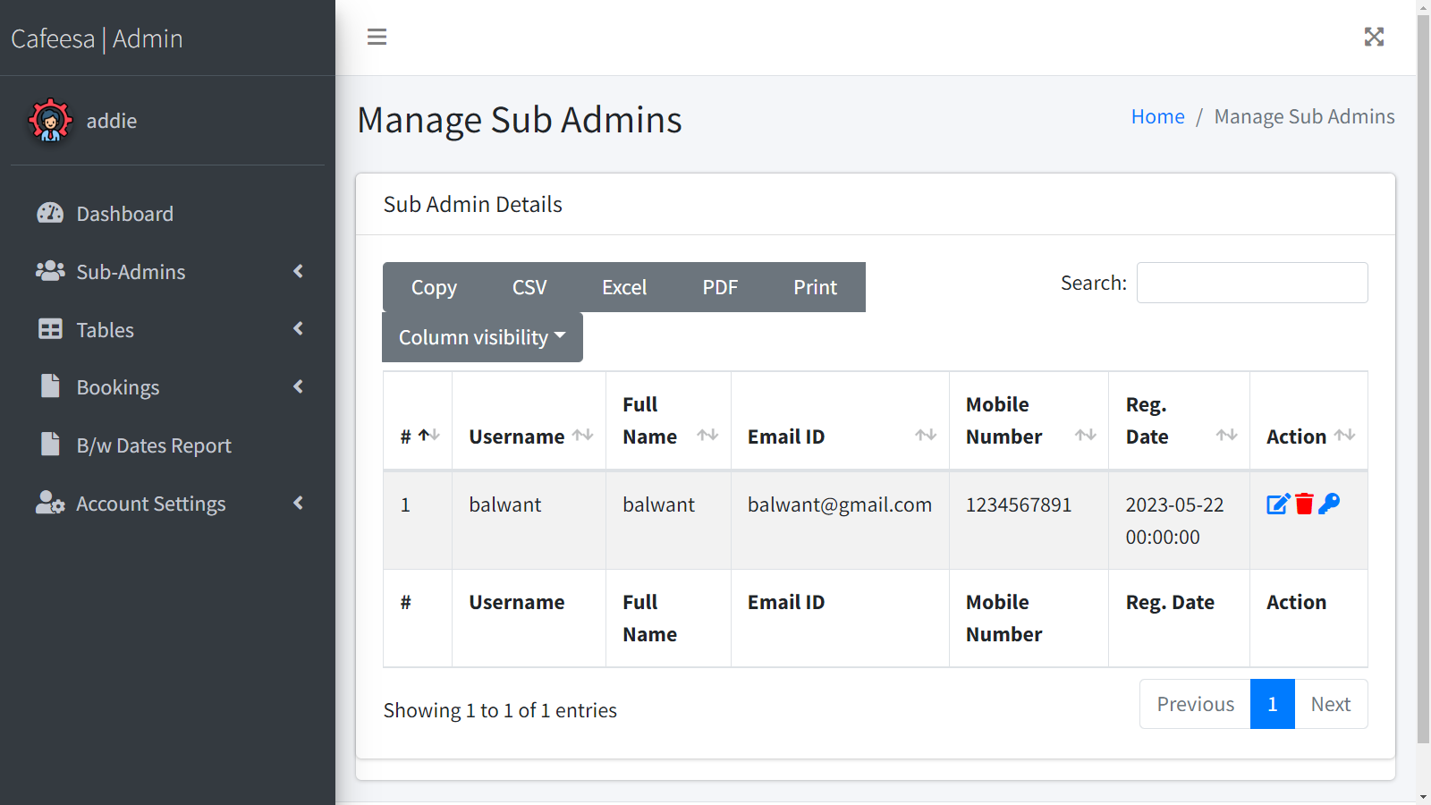
MANAGE SUB-ADMIN
Within the user management section, you should find options to add new sub-administrator accounts or edit existing ones. When adding a new sub-administrator, you typically need to provide a username, email address, password, and set permissions or roles for the account.

Slide 22
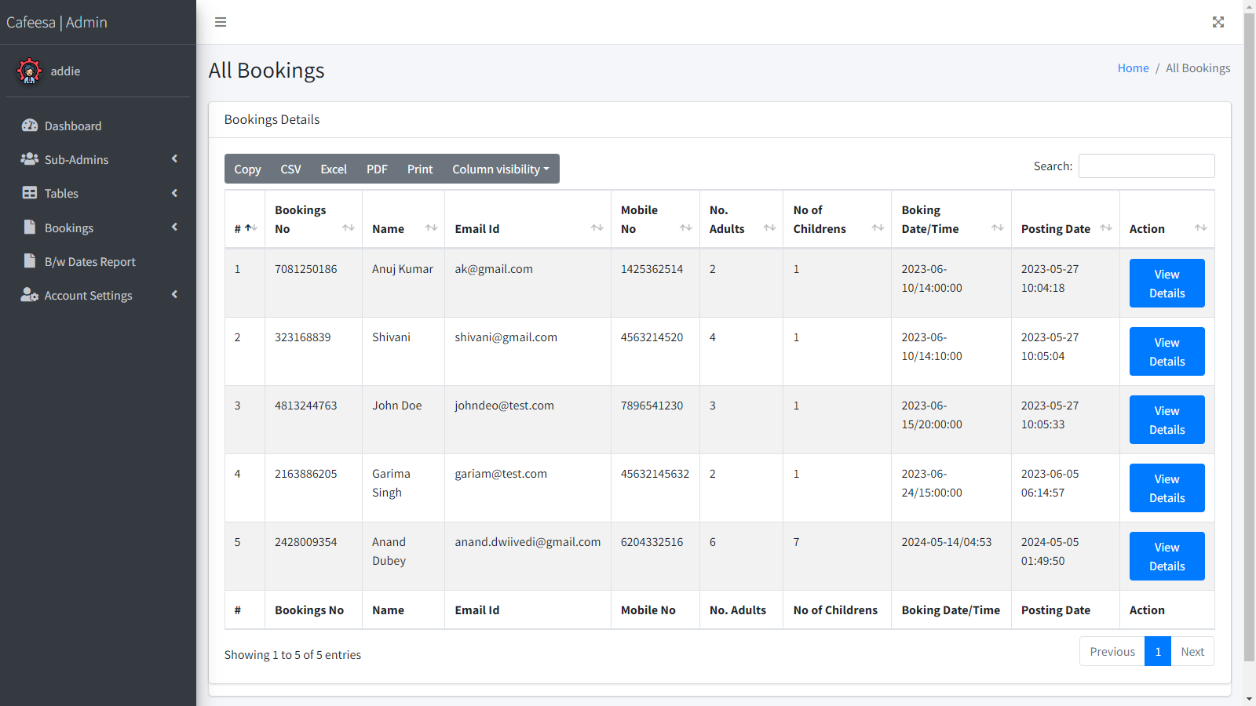
ALL-BOOKINGS
This page allows administrators to view, edit, and manage all reservations. It includes options to search for reservations, filter them by date or status, and perform actions such as approving, canceling, or modifying reservations.

Slide 23
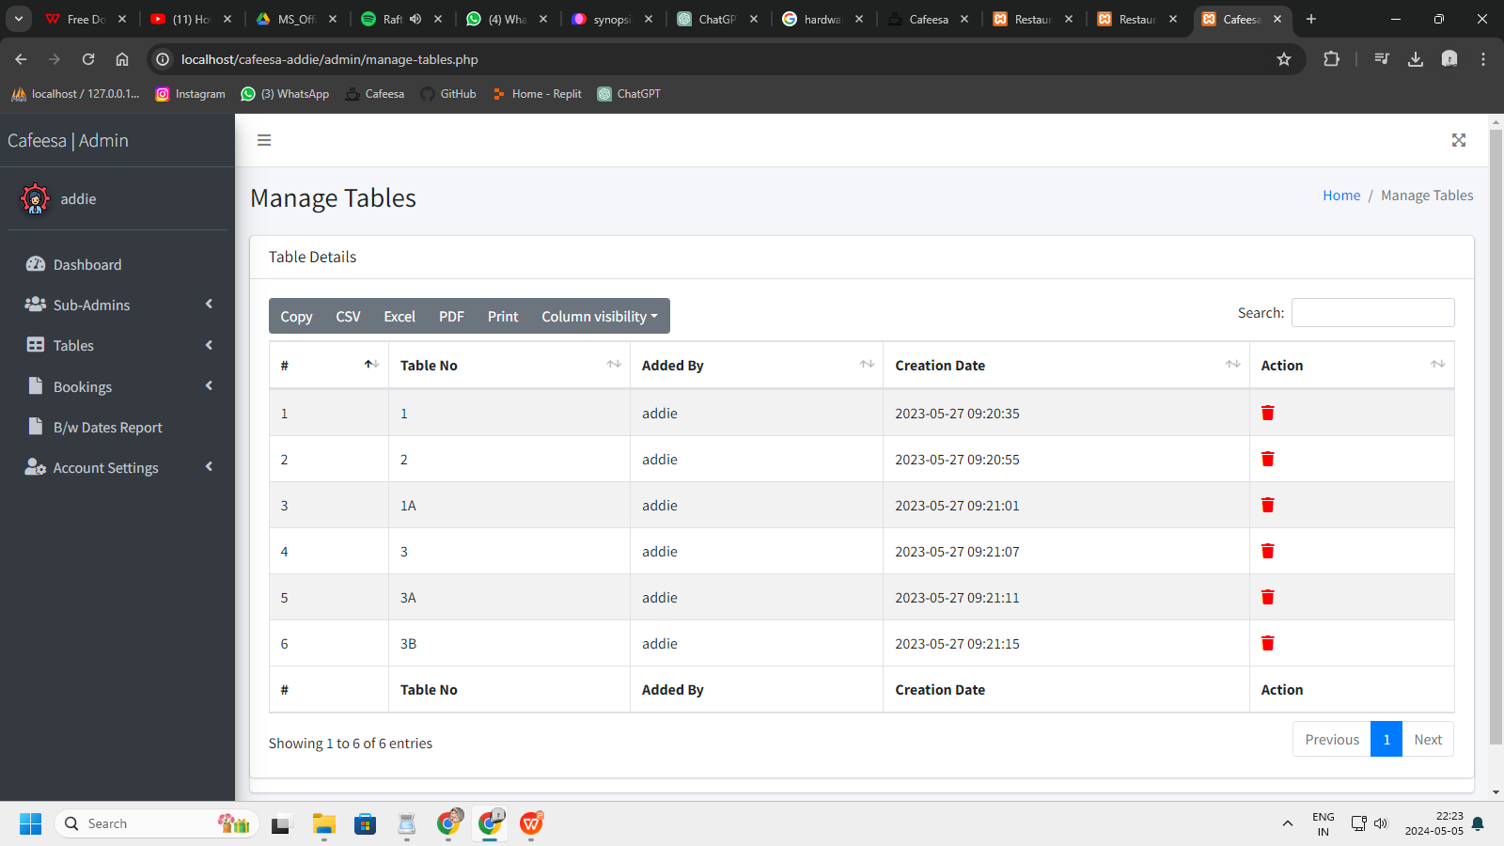
MANAGE TABLES
Administrators can add, edit, or delete tables from this page. It provides a visual representation of the restaurant layout, allowing admins to assign tables to specific areas, set capacities, and mark tables as available or reserved.

Slide 24
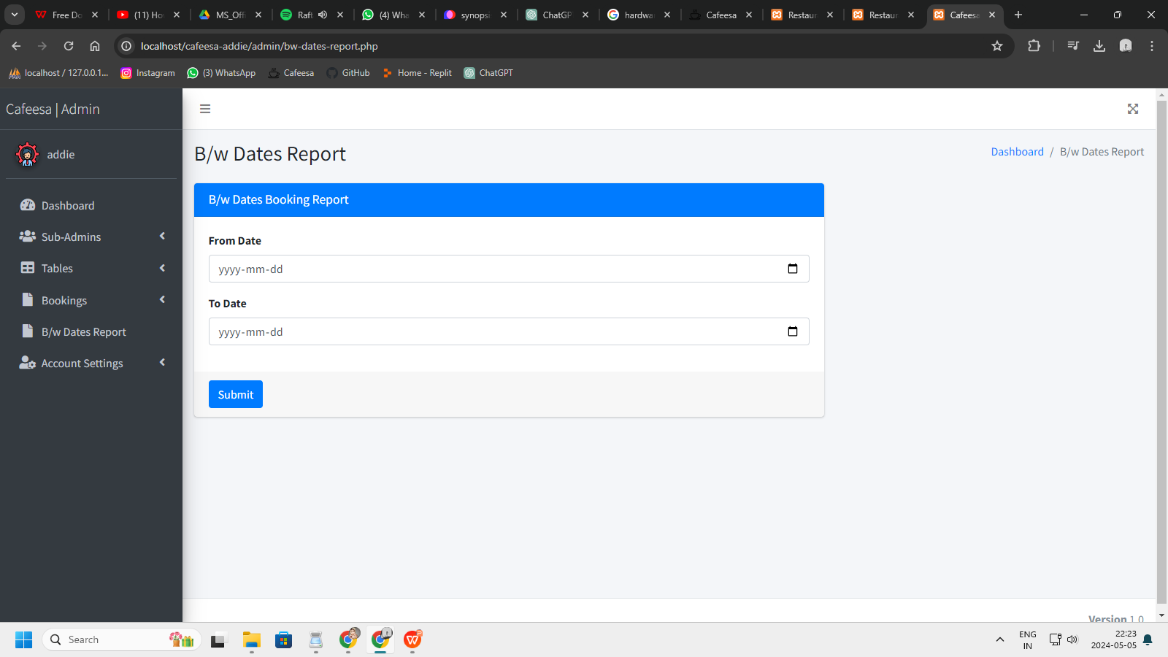
B/W-DATES REPORT
This page provides detailed reports and analytics on various aspects of the restaurant's operations, including sales performance, reservation trends, , and staff productivity.

Slide 25
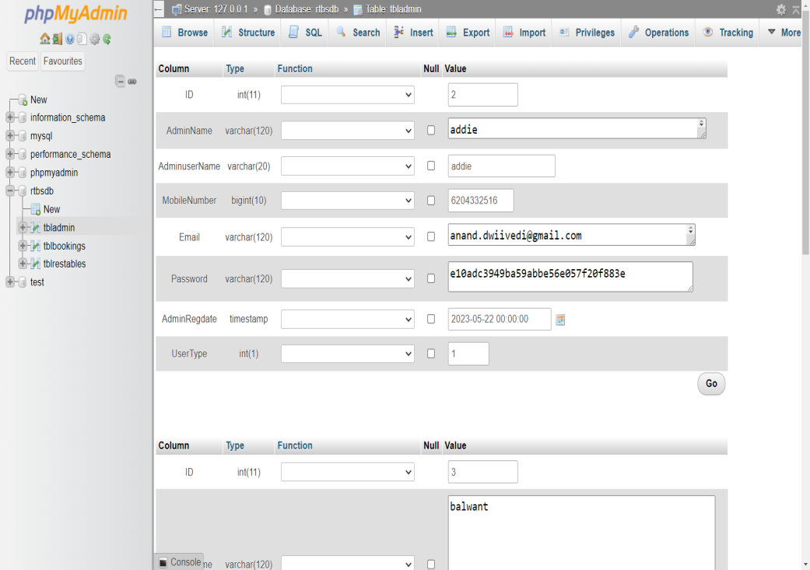


08
Database-Structure
MANAGE-ADMIN

Slide 26
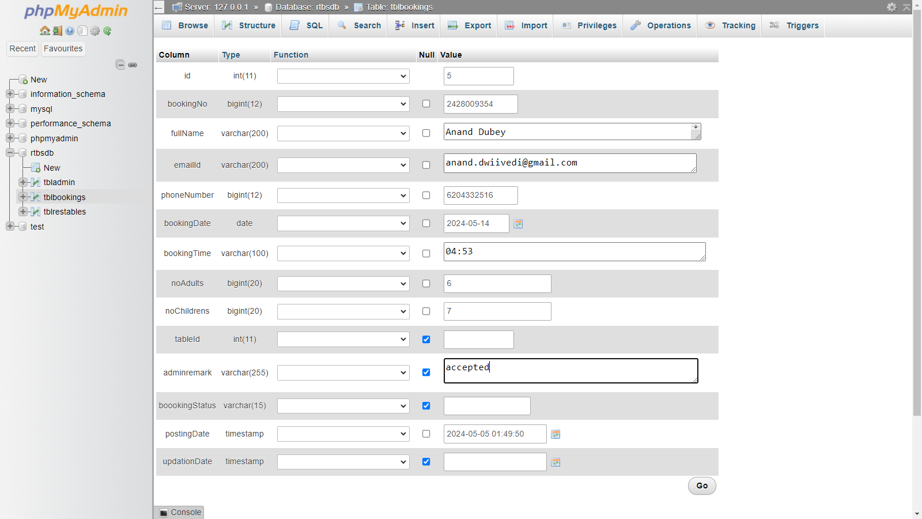
MANAGE-BOOKINGS

Slide 27
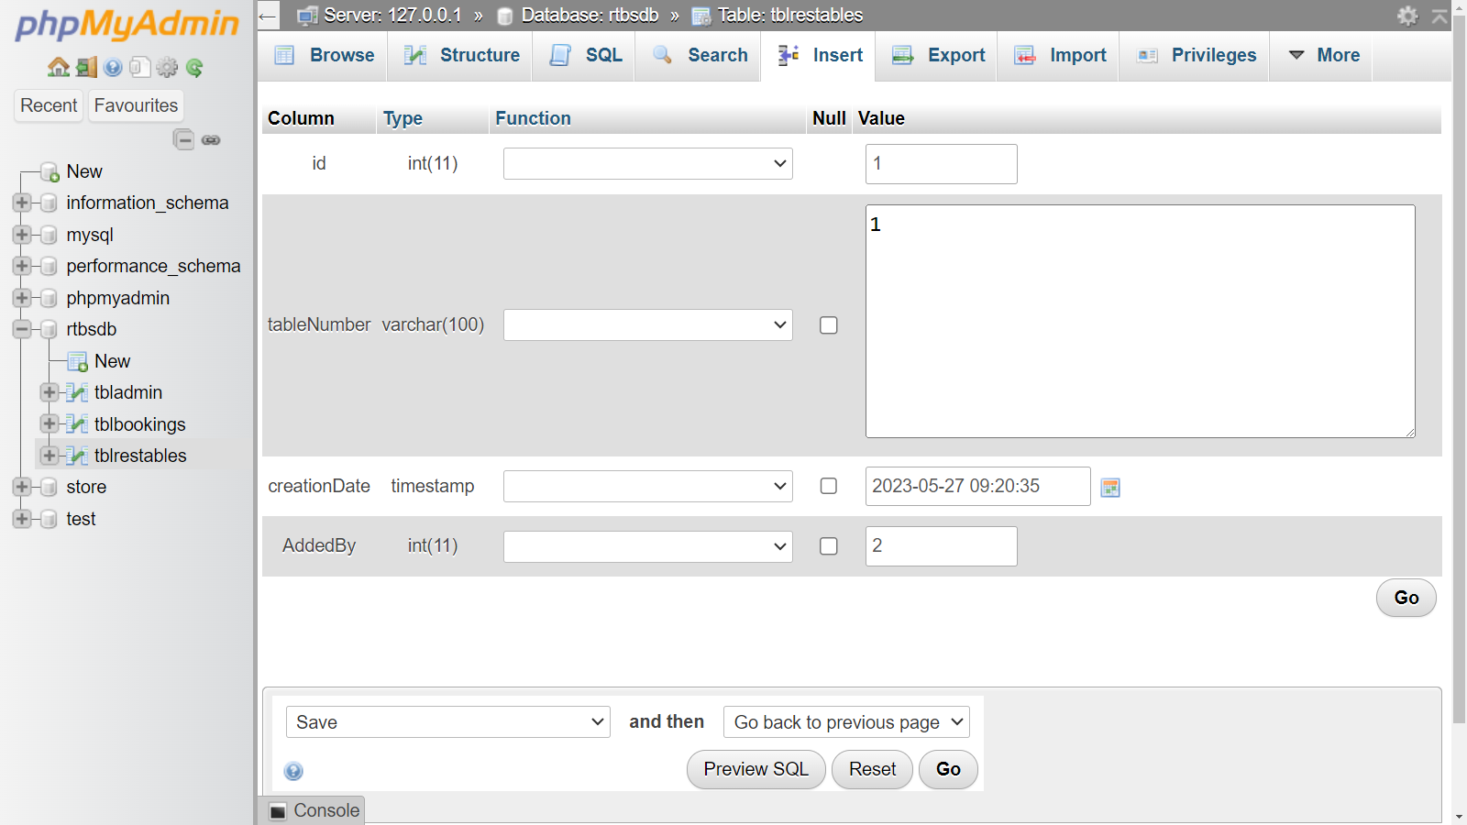
MANAGE-TABLES

Slide 28


09
CONCLUSION
The implementation of a table reservation feature on the Cafeesa website represents a strategic initiative to enhance the dining experience for customers while optimizing operational efficiency for the cafe. By providing a user-friendly booking platform, real-time availability updates, and seamless integration with the POS system, the feature aims to streamline the reservation process and maximize customer satisfaction. As a result, Cafeesa can expect to see increased patronage, improved table turnover rates, and enhanced customer loyalty, contributing to the cafe's overall success and growth trajectory.

Slide 29
10
Reference
01
CHATGPT
https://chat.openai.com/
02
GITHUB
https://github.com/
03
HTML-DESIGN
https://html.design/

Slide 30

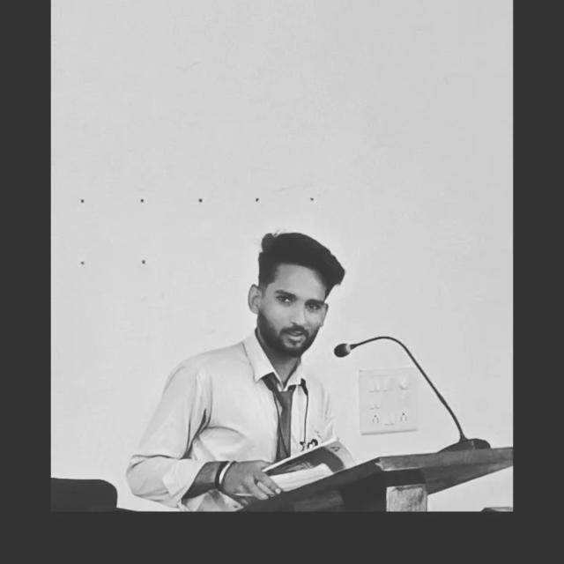




THANK YOU!
Anand Dubey
+91 6204332516
anand.dwiivedi@gmail.com
www.cafeesa-addie.com
No-Where

